Slide 1
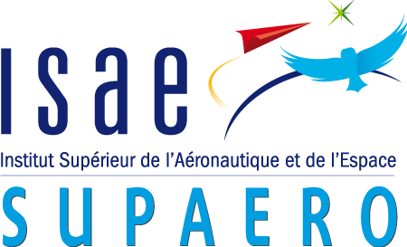
Multifidelity aeroelastic optimization with application to a BWB
S2 project report
Author: Gilberto ruiz jiménez
Supervisors: Joseph morlier & Joan mas colomer

Slide 2
Contents
Introduction
State of the art
Previous work
Proposed method
Preliminary Results
Future work

Slide 3
Introduction
Fluid-Structure Interaction (FSI) is a key feature in aircraft design.
Uncertainties on the aeroelastic behaviour lead to excessive safety margins.
In order to optimize w.r.t. aeroelastic behaviour, the coupled system must be solved many times.
Ideally, this analysis should be carried out from the very early stages of the design phase.
Additional costs
Non-optimal structure

Slide 4

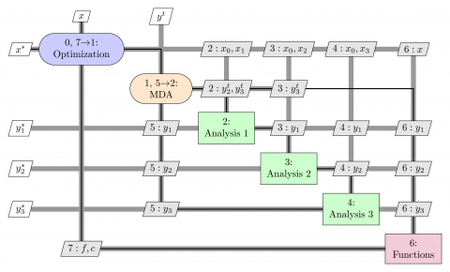
Introduction: Multidisciplinary Optimization
Methodology for the design of systems where the interaction between several disciplines must be considered [3] Gray et al. AIAA/ISSMO
An MDO architecture:
Decomposes a complex system in manageable parts
Coordinates the parts interactions
Searches the overall system optimum
OpenMDAO
Python-based, open source framework for coupling multiple models and optimization
Figure 2. XDSM diagram, MDF architecture. [3] Gray et al. AIAA/ISSMO

Slide 5
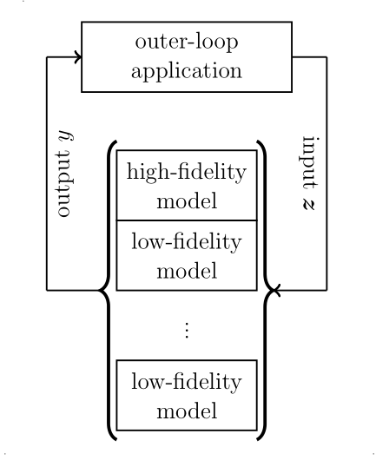
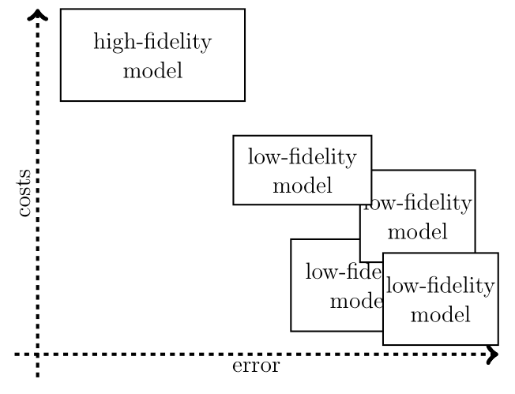
Goal of the Project.
MDO libraries allow the user to couple both disciplines and optimize w.r.t. established bounds & variables
High-Fidelity simulations offer accurate results but are often too expensive for direct design optimizations.
Low-Fidelity analysis offer reasonable approximations with low computational demands.
This project aims to combine low and high-Fidelity analysis to conduct aeroelastic optimization, and apply the method to a BWB configuration.
Figure 2. Multifidelity methods leverage error and costs to speedup simulations. [7] Peherstorfer et al. SIAM Review

Slide 6
Contents
Introduction
State of the art
Previous work
Proposed method
Preliminary Results
Future work

Slide 7
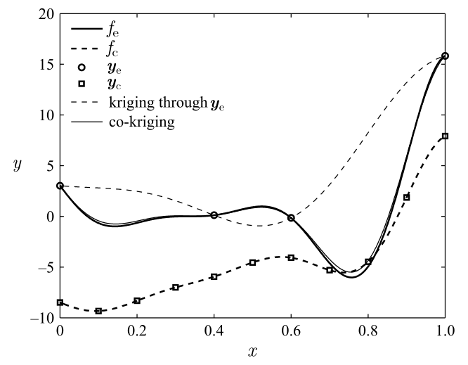
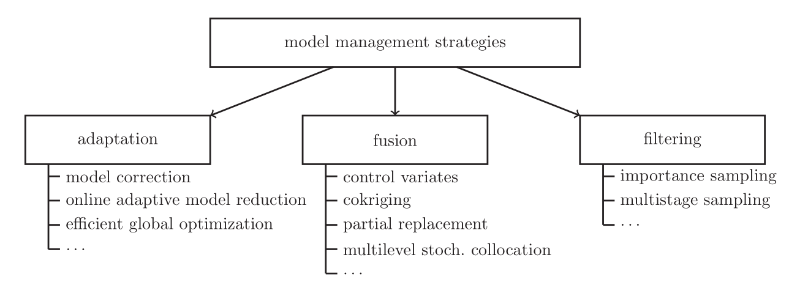
State of the art
[7] Peherstorfer et al. SIAM Review
Figure 3. Kriging and co-kriging are fusion methods that combine low and high-Fidelity models.
[2] Forrester et al. Proc. Royal Soc. Lond
Notes:
Our strategy is a filtering method

Slide 8
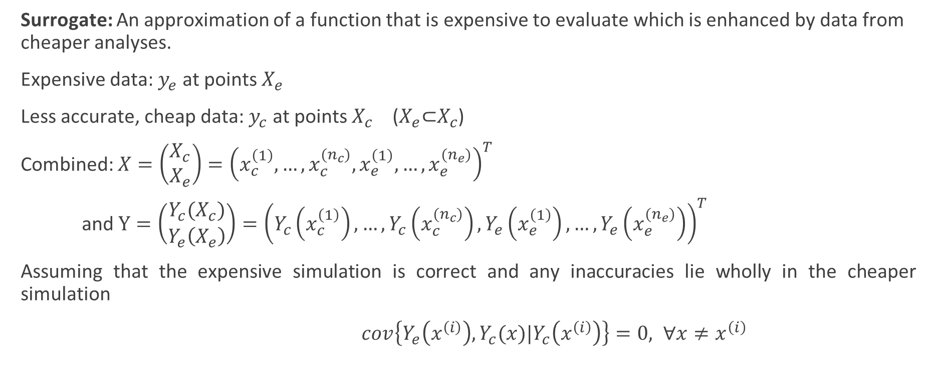
State of the art: Co-kriging
Surrogate: An approximation of a function that is expensive to evaluate which is enhanced by data from cheaper analyses.
Expensive data: $y_{e}$ at points $X_{e}$
Less accurate, cheap data: $y_{c}$ at points $X_{c}$ ($X_{e}\text{⊂}X_{c}$)
Combined: $X=\left(\begin{matrix}X_{c} \\ X_{e}\end{matrix}\right)={\left(x_{c}^{\left(1\right)},…,x_{c}^{{(n}_{c})},x_{e}^{\left(1\right)},…,x_{e}^{{(n}_{e})}\right)}^{T}$
and $Y=\left(\begin{matrix}Y_{c}(X_{c}) \\ Y_{e}\left(X_{e}\right)\end{matrix}\right)={\left(Y_{c}\left(x_{c}^{\left(1\right)}\right),…,Y_{c}\left(x_{c}^{{(n}_{c})}\right),Y_{e}\left(x_{e}^{\left(1\right)}\right),…,Y_{e}\left(x_{e}^{{(n}_{e})}\right)\right)}^{T}$
Assuming that the expensive simulation is correct and any inaccuracies lie wholly in the cheaper simulation
$cov\left\{Y_{e}\left(x^{\left(i\right)}\right),Y_{c}(x)|Y_{c}\left(x^{\left(i\right)}\right)\right\}=0, ∀x≠x^{\left(i\right)}$
[2] Forrester et al. Proc. Royal Soc. Lond.

Slide 9
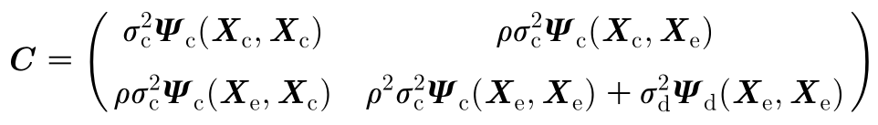
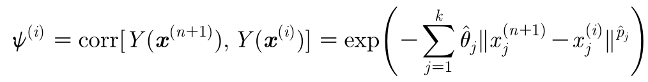
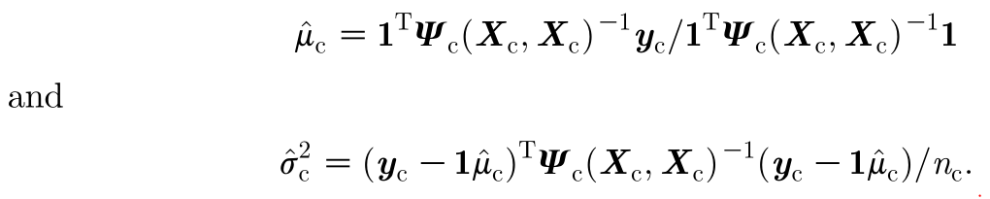

State of the art: Co-kriging
Expensive code = cheap code multiplied by a scaling factor ρ plus a Gaussian process $Z_{d}$
$$Z_{e}\left(x\right)=ρZ_{c}\left(x\right)+Z_{d}\left(x\right)$$
With the covariance matrix:
In order to find the hyperparameters, maximize ln-likelihood
Yielding:
[2] Forrester et al. Proc. Royal Soc. Lond.

Slide 10
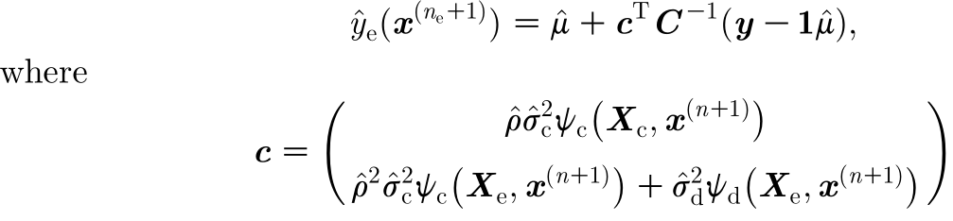

State of the art: Co-kriging
With the hyper-parameters estimated, the co-kriging prediction of the expensive function is given by:
[2] Forrester et al. Proc. Royal Soc. Lond.

Slide 11
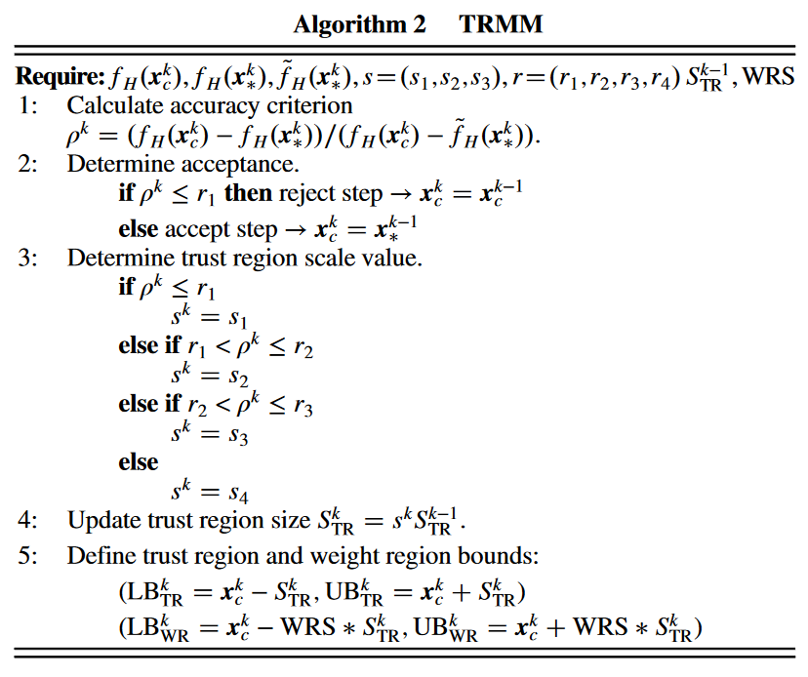
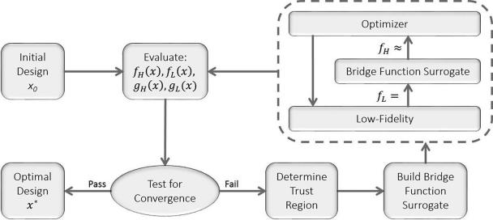
State of the art: Trust Region Model Management (TRMM)
[1] Fischer et al. AIAA

Slide 12
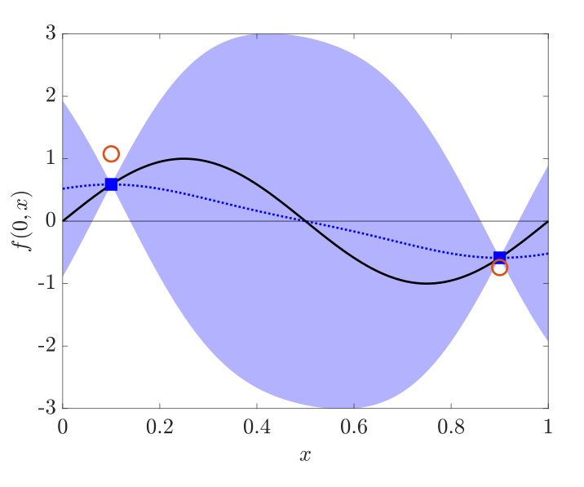
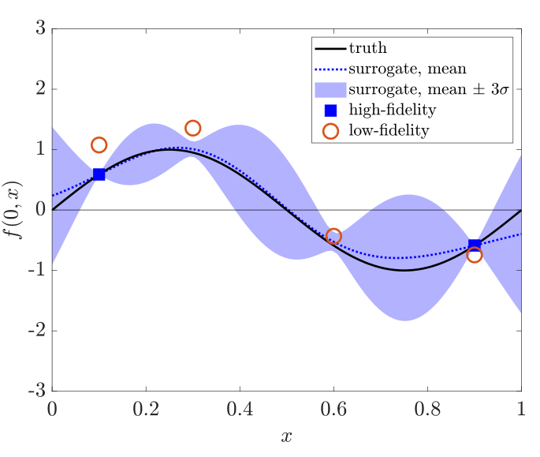
State of the art
Quasi-Newton Inverse Least Squares algorithm (QN-ILS)
ASM-ILS [8] Scholcz et al. Comput. Methods Appl. Mech Engrg.
Defect-correction [4] Jovanov & De Breuker, AIAA
Some other alternatives:
The linear regression approach: balances accuracy, cost and simplicity [9] Zhang et al. AIAA
Active learning approach: The flutter boundary can be found if treated as a contour location problem [5] Marques et al. AIAA
Figure 4. Low-Fidelity data improves prediction of High-Fidelity function. [5] Marques et al. AIAA
Notes:
ASM: Agressive Space Mapping
TRMM: Thrust Region Model Management

Slide 13
Contents
Introduction
State of the art
Previous work
Proposed method
Preliminary Results
Future work

Slide 14
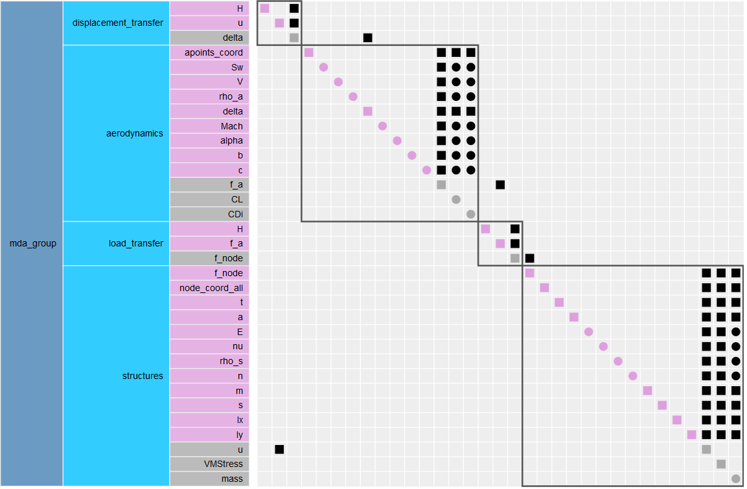
Previous work
The main base for the development of this project is the aerostructures package [6] Mas-Colomer Univ. Toulouse
Python library, facilitates the creation of MDA and MDAO problems in OpenMDAO.
Combines structural solvers (NASTRAN) with fluid solvers (Panair, ADFlow)
A simple example of the implementation of this python library was provided by the author for both the low and high fidelity cases.
Figure 5. $N^{2}$ Diagram of the MDA for the sample problem. Generated using OpenMDAO.

Slide 15
Previous work
The structure module computes nodal displacements.
As both disciplines do not share the same mesh topology, loads and displacements cannot be directly exchanged.
Radial Basis Functions
One module interpolates the displacement field from the structural nodes to the aerodynamic points
Another one transfers the aerodynamic loads to the structural nodes while preserving the total load and moment
The coupled system is solved using iterative methods readily available in the OpenMDAO platform.
Gauss-Seidel
Notes:
given the geometry of the structure, its material properties, and the input nodal forces
To exchange loads and displacements, we use the method based on the radial basis functions (RBF)

Slide 16
Contents
Introduction
State of the art
Previous work
Proposed method
Preliminary Results
Future work

Slide 17
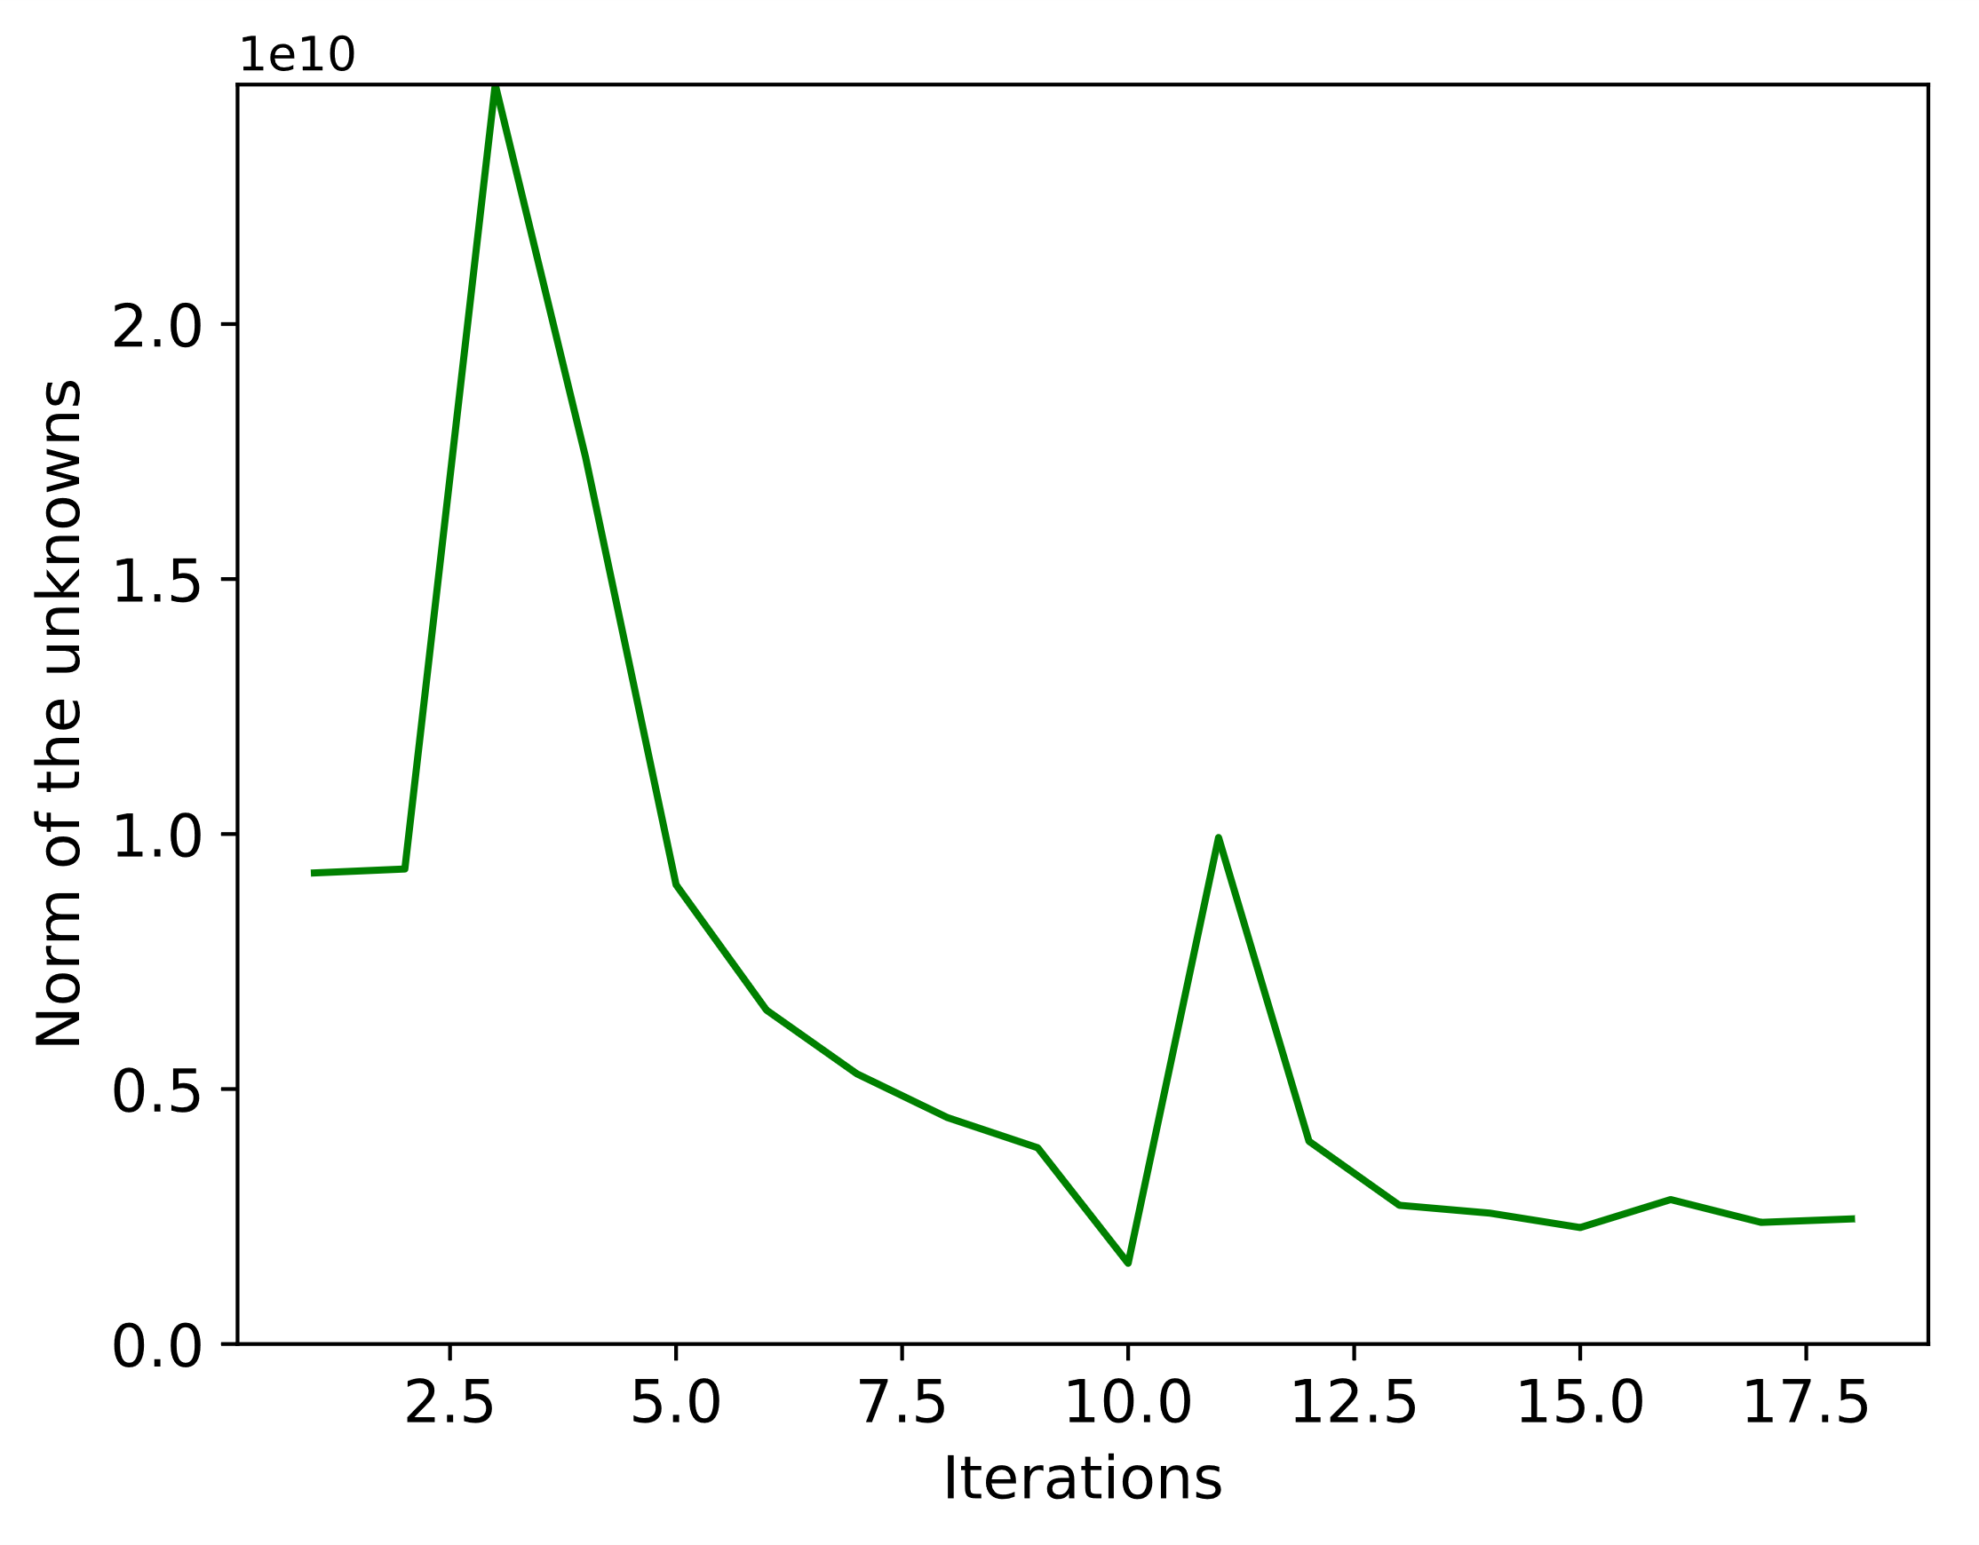
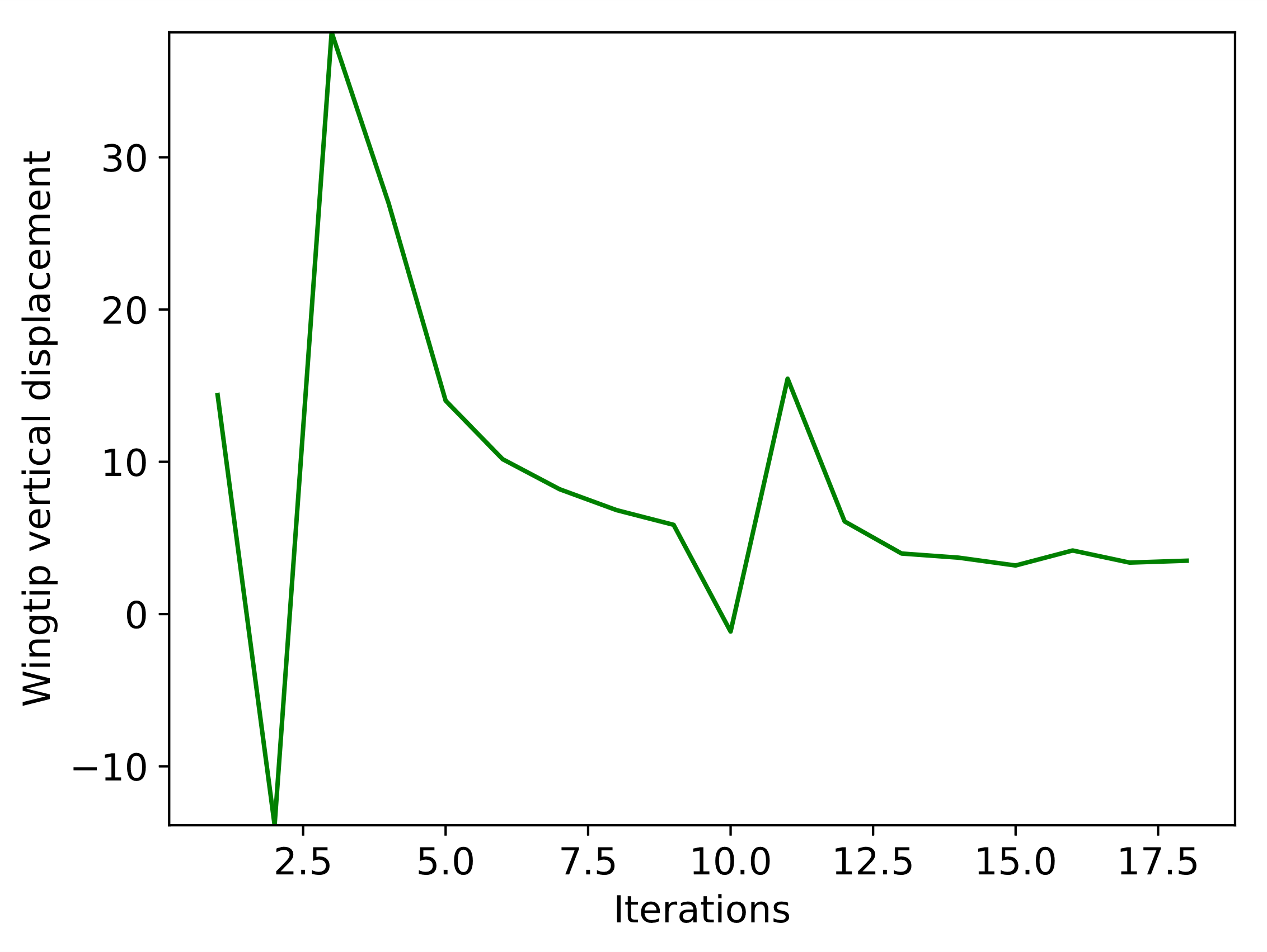
Proposed method
Most of the state of the art methods consider the solvers as black boxes
The advantage of OpenMDAO, NASTRAN95, ADFlow and Panair: They are Open-Source Tools
Why not leverage this advantage to connect both fidelities at the MDA level?
Start
PANAIR
Initial disp.
Fidelity Change
AdFlow
Inherit PANAIR solution
Outer Loop Optimizer
Possible surrogate?
Figure 6. Solution monitors for the MDA problem.

Slide 18
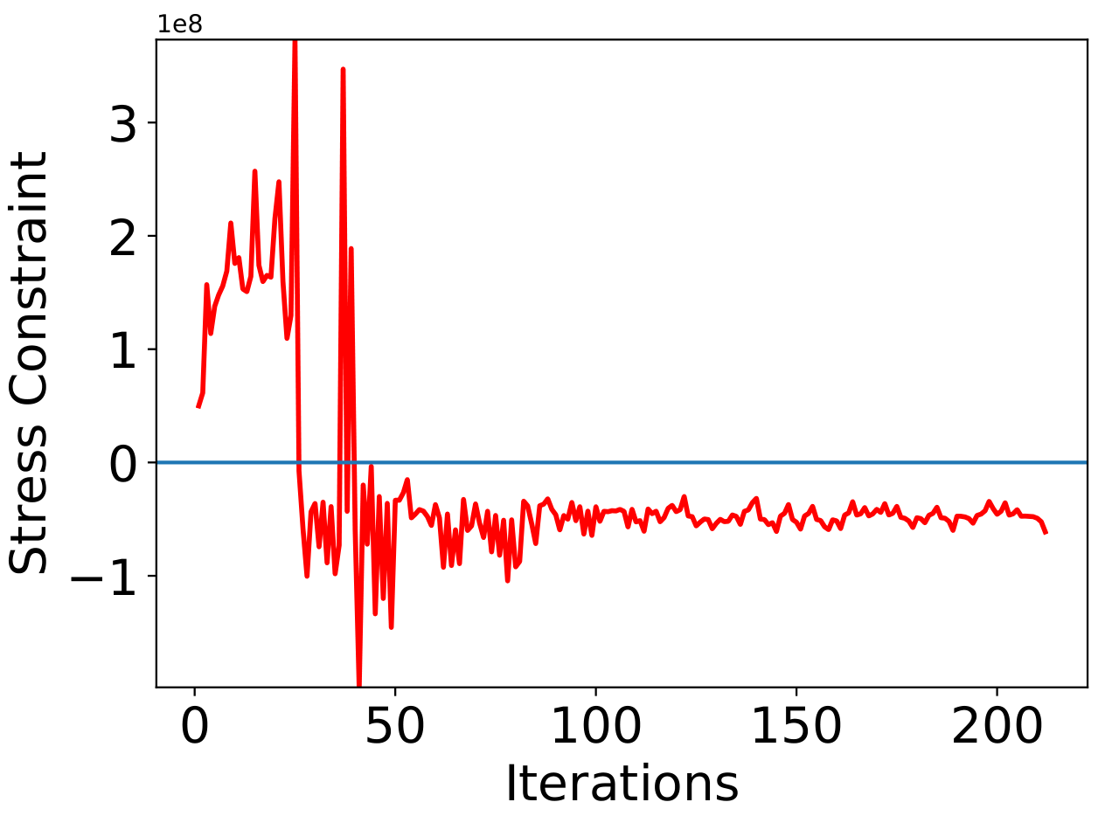
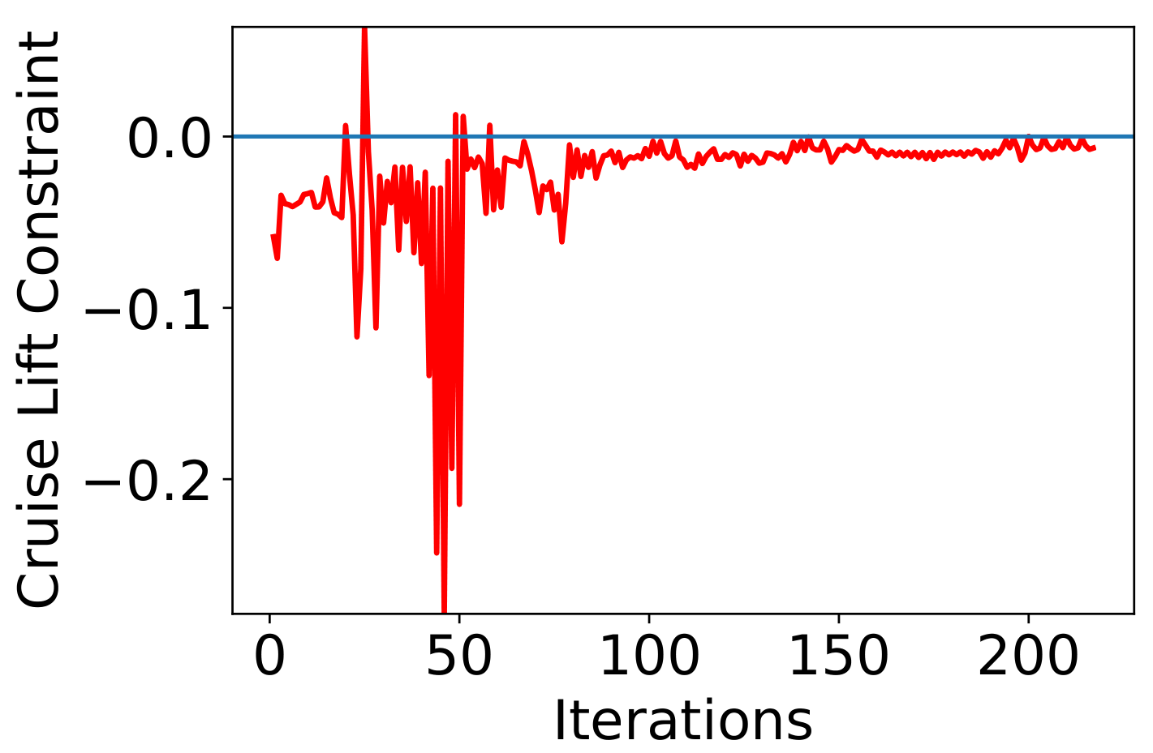
Proposed method
An outer loop surrogate built from the MDA solution can be added.
This would reduce MDA calls, as the surrogate would be evaluated instead.
However, it adds computation time to create and tune the surrogate…
Still early to tell if this part of the method is feasible/convenient.
Figure 7. Solution monitors for the MDAO problem.

Slide 19
Contents
Introduction
State of the art
Previous work
Proposed method
Preliminary Results
Future work

Slide 20
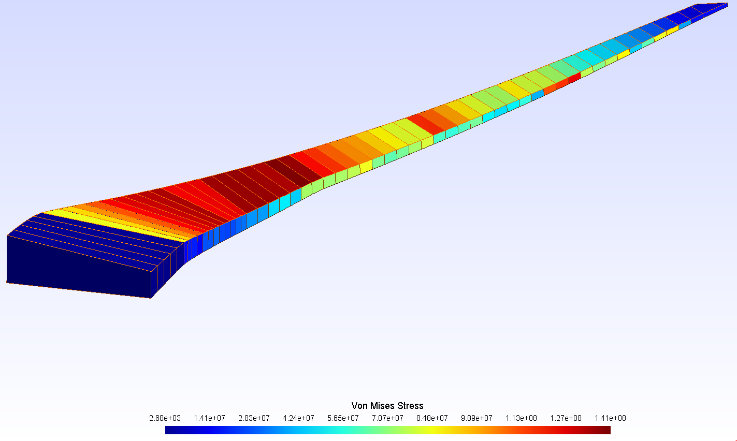
Preliminary results
Establish Low and High fidelity models and their isolated implementation.
Low-fidelity model: PANAIR. Implemented over a wing model.
High-fidelity model: ADFlow. Implemented over a wing model.
Define the way the Low-Fidelity model exchanges data with the High-Fidelity one.
When both meshes coincide, direct exchange is possible.
Else, map the data from one fidelity to the next
Figure 8. Von Mises Stress on the sample wing problem (NASA CRM), low, single fidelity optimization. Structural Mesh.

Slide 21
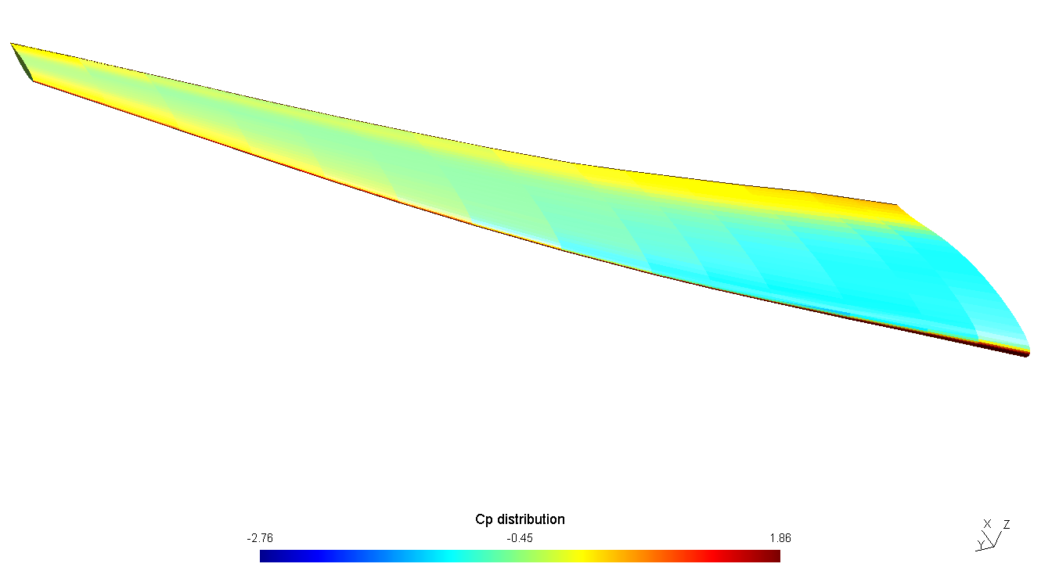
Preliminary results
Determine the criteria that triggers the alternation from low to high fidelity.
When a certain constraint convergence value is reached.
The High-Fidelity implementation is ready to be executed, but not yet reported due to time constraints.
Figure 9. Cp distribution on the sample wing problem, low, single fidelity optimization. Fluid Mesh.

Slide 22
Contents
Introduction
State of the art
Previous work
Proposed method
Preliminary Results
Future work

Slide 23
Conclusions & Future work
Write the code that connects both fidelity levels in OpenMDAO.
Run the multi-fidelity optimization for the sample case.
Check performance of the new proposal vs. previous code and single fidelity.
Apply the method to a BWB configuration and validate the results.
Check for possible performance improvements for the complex case.

Slide 24
Bibliography
[1] Fischer, C. C., Grandhi, R. V., & Beran, P. S. (2018). Bayesian-Enhanced Low-Fidelity Correction Approach to Multifidelity Aerospace Design. AIAA Journal, 56(8), 3295-3306.
[2] Forrester, A. I., Sóbester, A., & Keane, A. J. (2007). Multi-fidelity optimization via surrogate modelling. Proceedings of the royal society a: mathematical, physical and engineering sciences, 463(2088), 3251-3269.
[3] Gray, J., Moore, K., & Naylor, B. (2010, September). OpenMDAO: An open source framework for multidisciplinary analysis and optimization. In 13th AIAA/ISSMO Multidisciplinary Analysis Optimization Conference (p. 9101).
[4] Jovanov, K., & De Breuker, R. (2015). Accelerated convergence of static aeroelasticity using low-fidelity aerodynamics. In 56th AIAA/ASCE/AHS/ASC Structures, Structural Dynamics, and Materials Conference (p. 0175).
[5] Marques, A. N., Lam, R., Chaudhuri, A., Opgenoord, M. M., & Willcox, K. E. (2019). A multifidelity method for locating aeroelastic flutter boundaries. In AIAA Scitech 2019 Forum (p. 0438).
[6] Mas-Colomer, J. (2018). Aeroelastic Similarity of a Flight Demonstrator via Multidisciplinary Optimization (Doctoral dissertation, Université Fédérale de Toulouse).
[7] Peherstorfer, B., Willcox, K., & Gunzburger, M. (2018). Survey of multifidelity methods in uncertainty propagation, inference, and optimization. SIAM Review, 60(3), 550-591.
[8] Scholcz, T. P., van Zuijlen, A. H., & Bijl, H. (2014). Space-mapping in fluid–structure interaction problems. Computer Methods in Applied Mechanics and Engineering, 281, 162-183.
[9] Zhang, Y., Kim, N. H., Park, C., & Haftka, R. T. (2018). Multifidelity Surrogate Based on Single Linear Regression. AIAA Journal, 56(12), 4944-4952.

